Slide 1
Develop your own Machine Learning tools and workflows with OpendTect
Webinar – 22 April 2021 David Markus, Machine Learning Evangelist

Slide 2
Outline
OpendTect Machine Learning Plugin
Workflows
Pre-Trained Models
Experimentation
Development Environment
Architecture
Keras and Tensorflow
OpendTect API
IDE
Notebooks
Putting it all together
Prepare development environment
Launch Python shell
Launch favorite IDE
Create a Notebook
Demonstrate workflow using plugin and notebook together

Slide 3
OpendTect
OpendTect Machine Learning Plugin
Workflows
Pre-Trained Models
Experimentation
Development Environment
Architecture
Keras and Tensorflow
OpendTect API
IDE
Notebooks
Putting it all together
Prepare development environment
Launch Python shell
Launch favorite IDE
Create a Notebook
Demonstrate workflow using plugin and notebook together
Free Seismic Interpretation System
2D and 3D seismic
Supported on Linux, Windows, and MacOS
Free Software Development Platform
Open Source (available on Github)
C++ and Python Environments
Develop your own plugins
Use commercially or share
Extendable with Commercial Plugins
Closed Source
Multiple Vendors
Supported by dGB Earth Sciences

Slide 4
Workflows
OpendTect Machine Learning Plugin
Workflows
Pre-Trained Models
Experimentation
Development Environment
Architecture
Keras and Tensorflow
OpendTect API
IDE
Notebooks
Putting it all together
Prepare development environment
Launch Python shell
Launch favorite IDE
Create a Notebook
Demonstrate workflow using plugin and notebook together
We use ML to find and delineate complex relationships and structures in geoscience data sets.
Clustering
Classification
Regression
Seismic only
Clustering seismic for facies identification,
Imaging Faults
Transforming seismic to broadband, etc
Wells only
Predicting missing logs
Classifying lithology, etc
Seismic and Wells
Regression for predicting Rock Properties, etc

Slide 5
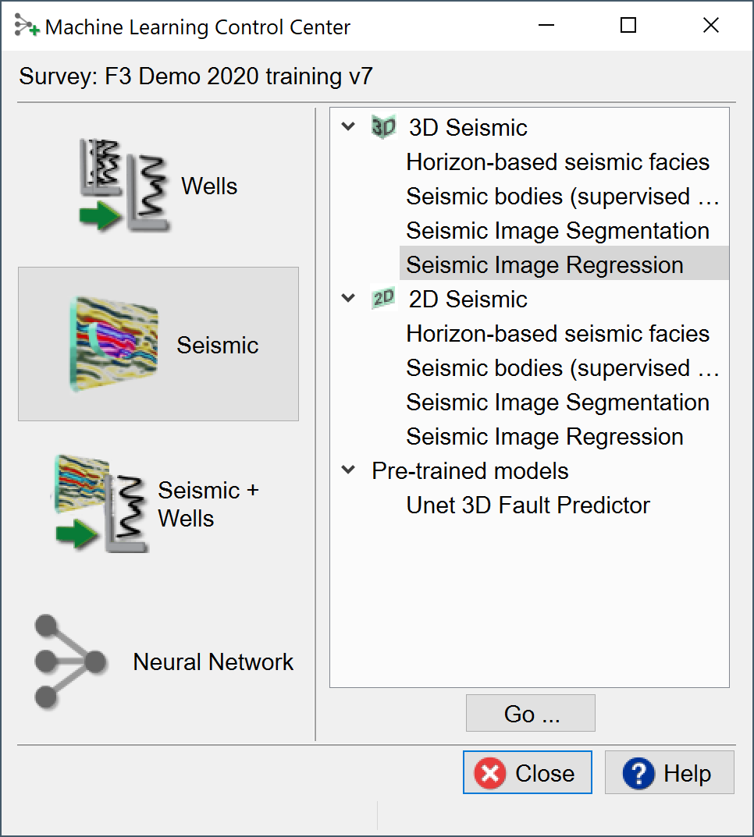
Pre-Trained Models
OpendTect Machine Learning Plugin
Workflows
Pre-Trained Models
Experimentation
Development Environment
Architecture
Keras and Tensorflow
OpendTect API
IDE
Notebooks
Putting it all together
Prepare development environment
Launch Python shell
Launch favorite IDE
Create a Notebook
Demonstrate workflow using plugin and notebook together
The ML Plugin comes with pre-trained models
U-Net model for identifying faults is a robust pre-trained model that identifies faults based on Fault and Fracture attributes generated from within OpendTect
Pre-trained models may also be developed and shared within an organization

Slide 6
Machine Learning Platform
OpendTect Machine Learning Plugin
Workflows
Pre-Trained Models
Experimentation
Development Environment
Architecture
Keras and Tensorflow
OpendTect API
IDE
Notebooks
Putting it all together
Prepare development environment
Launch Python shell
Launch favorite IDE
Create a Notebook
Demonstrate workflow using plugin and notebook together
Commercial Machine Learning Plugin
Links OpendTect to Python, Tensorflow, Keras, Scikit-Learn and other user-selectable modules
Speeds up Machine Learning R&D
Data I/O transparent to developer
Access to all workflows in OpendTect
Integrated plugin allows training and application of models directly within OpendTect
External Python development environment allows model creating, training and experimentation in programmatic setting
Full ecosystem of Python open-source modules available to augment development
Create repeatable science with Python notebooks
Share and deploy models within an organization or publicly

Slide 7
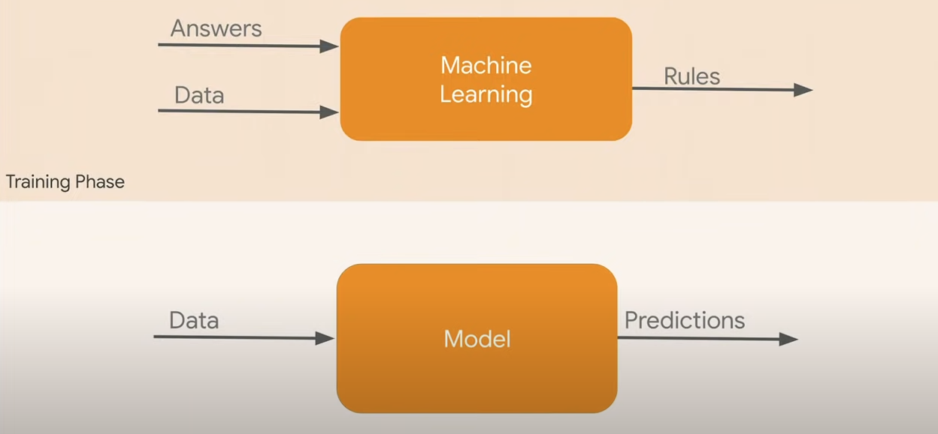
Machine Learning (in Two Bubbles)

Slide 8
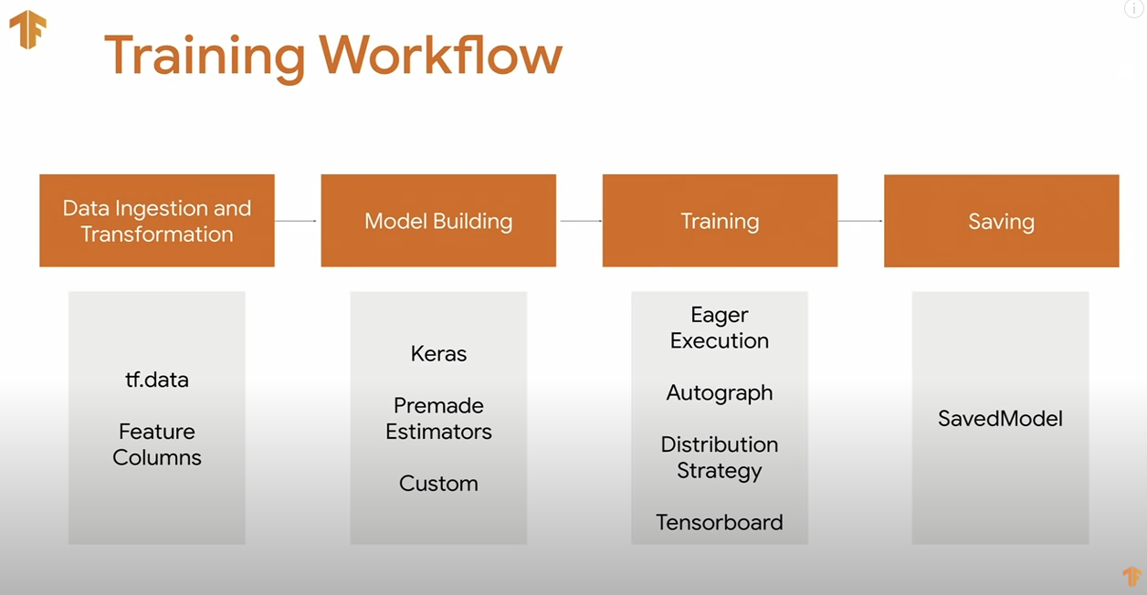
Training Workflow

Slide 9
Outline
OpendTect Machine Learning Plugin
Workflows
Pre-Trained Models
Experimentation
Development Environment
Architecture
Keras and Tensorflow
OpendTect API
IDE
Notebooks
Putting it all together
Prepare development environment
Launch Python shell
Launch favorite IDE
Create a Notebook
Demonstrate workflow using plugin and notebook together

Slide 10

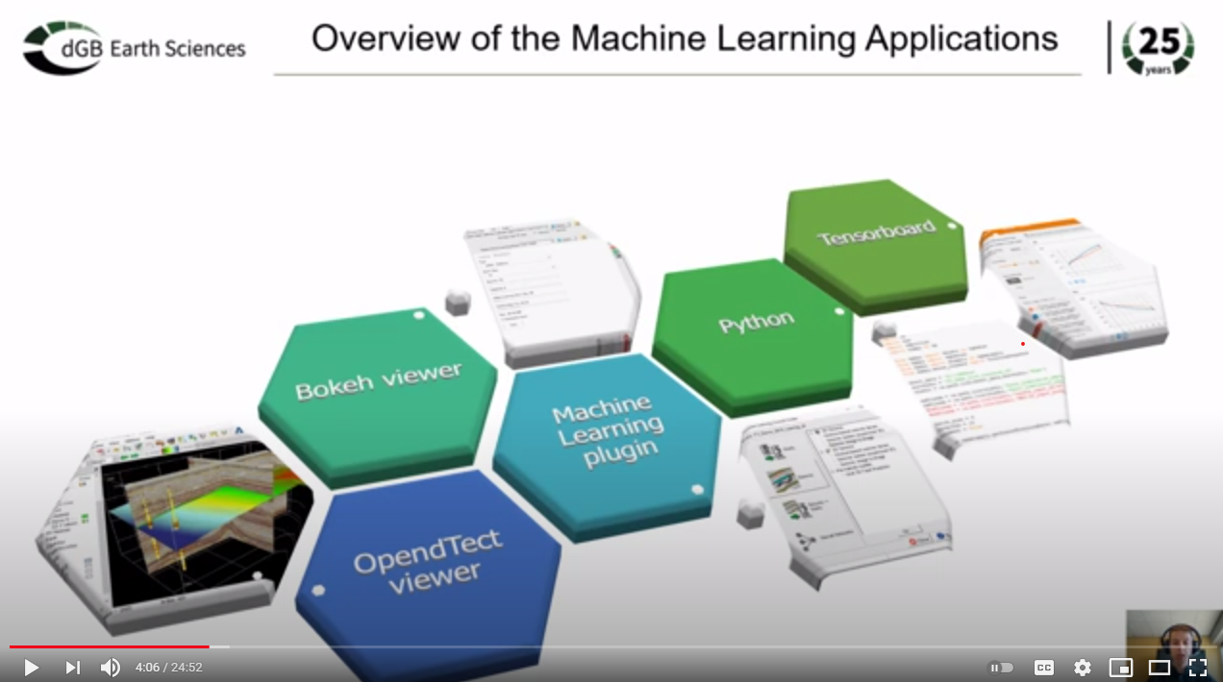
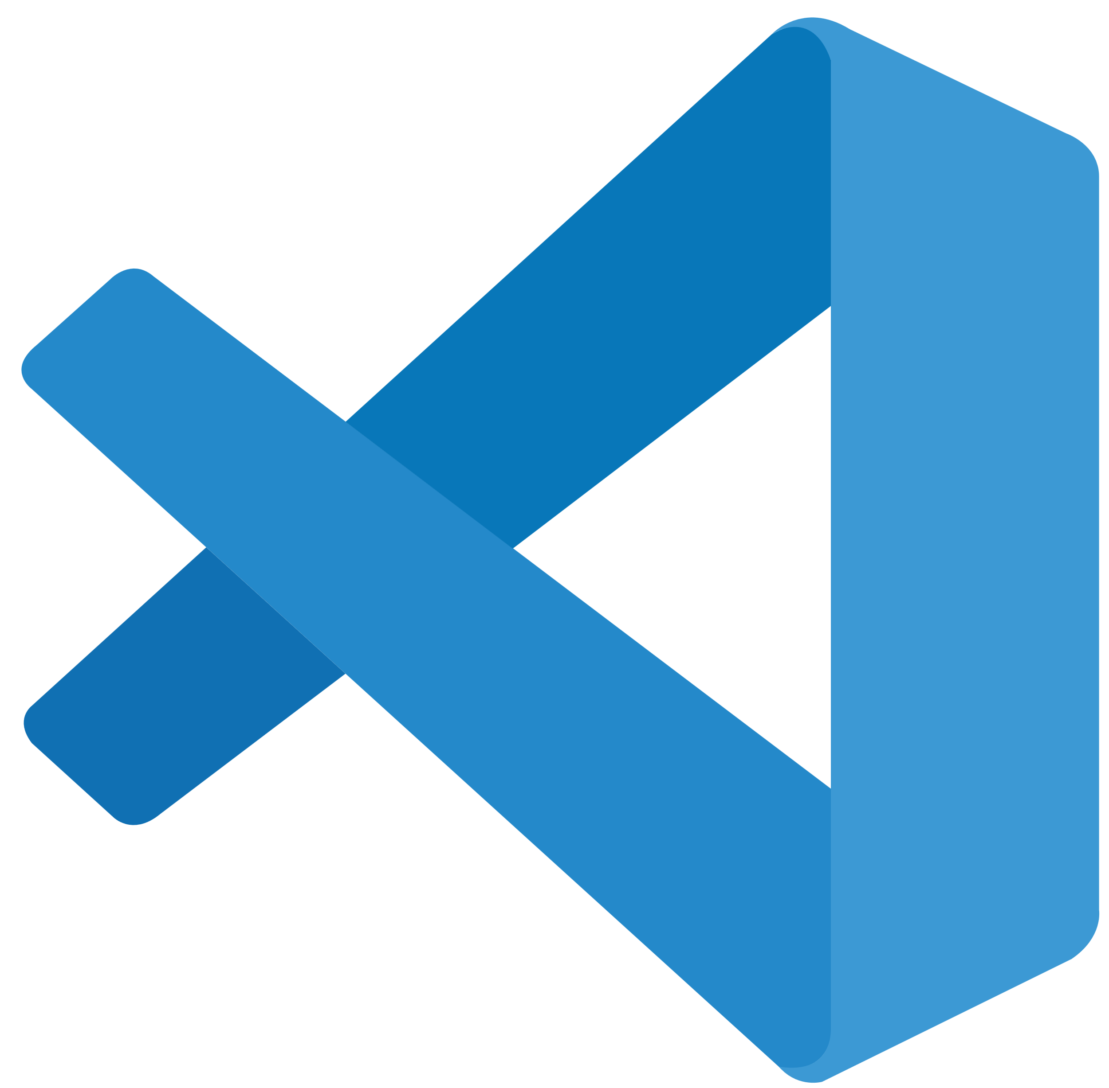


Outline
OpendTect Machine Learning Plugin
Workflows
Pre-Trained Models
Experimentation
Development Environment
Architecture
Keras and Tensorflow
OpendTect API
IDE
Notebooks
Putting it all together
Prepare development environment
Launch Python shell
Launch favorite IDE
Create a Notebook
Demonstrate workflow using plugin and notebook together
OpendTect ML Architecture

Slide 11
Outline
OpendTect Machine Learning Plugin
Workflows
Pre-Trained Models
Experimentation
Development Environment
Architecture
Keras and Tensorflow
OpendTect API
IDE
Notebooks
Putting it all together
Prepare development environment
Launch Python shell
Launch favorite IDE
Create a Notebook
Demonstrate workflow using plugin and notebook together

Slide 12

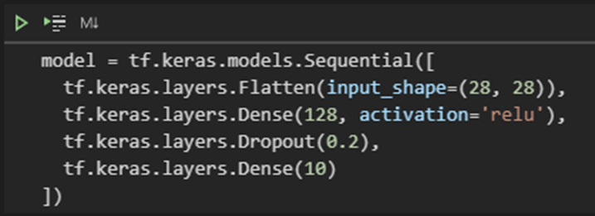
Outline
OpendTect Machine Learning Plugin
Workflows
Pre-Trained Models
Experimentation
Development Environment
Architecture
Keras and Tensorflow
OpendTect API
IDE
Notebooks
Putting it all together
Prepare development environment
Launch Python shell
Launch favorite IDE
Create a Notebook
Demonstrate workflow using plugin and notebook together
Keras is a high-level API
Written in Python
Provides a human-readable interface to Tensorflow
Easy to implement ML algorithms without knowing implementation details
Select distributed or multi-GPU processing
Tensorflow is a low-level API
Written largely in C/C++ and native GPU
Has API implementations for Python, C, Java, Go, etc
Provides engineers with performance tweaks by working with low-level functions

Slide 13
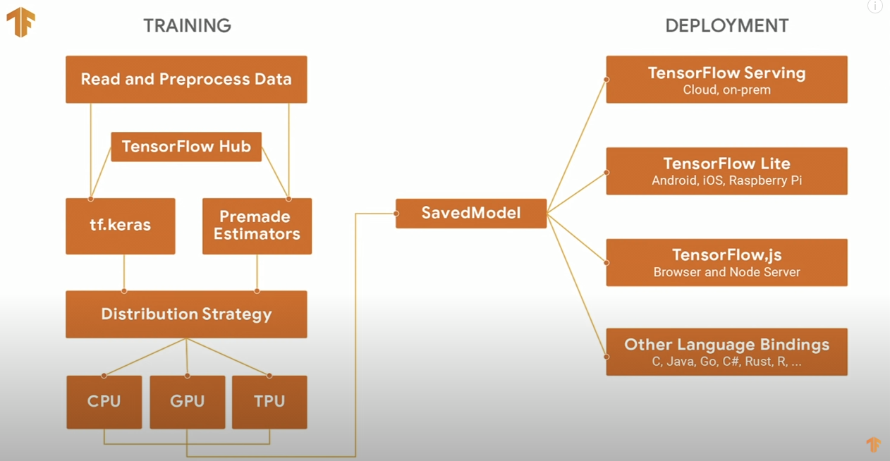

Building a model
OpendTect API

Slide 14
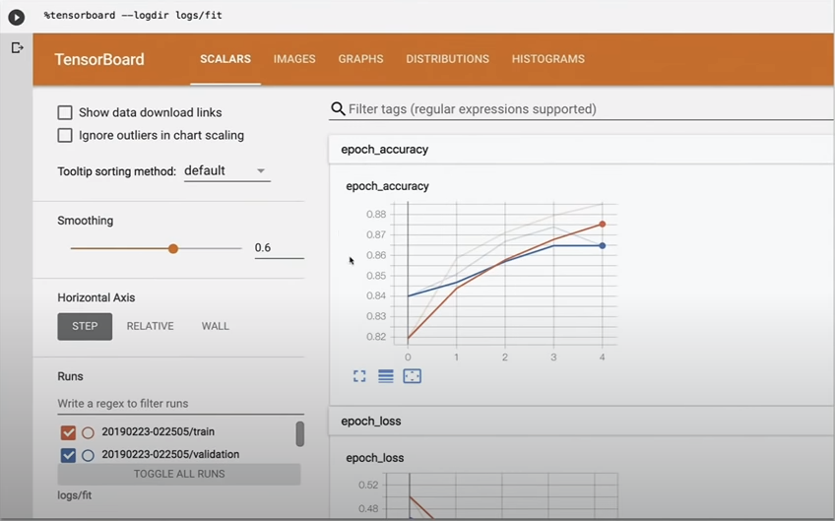
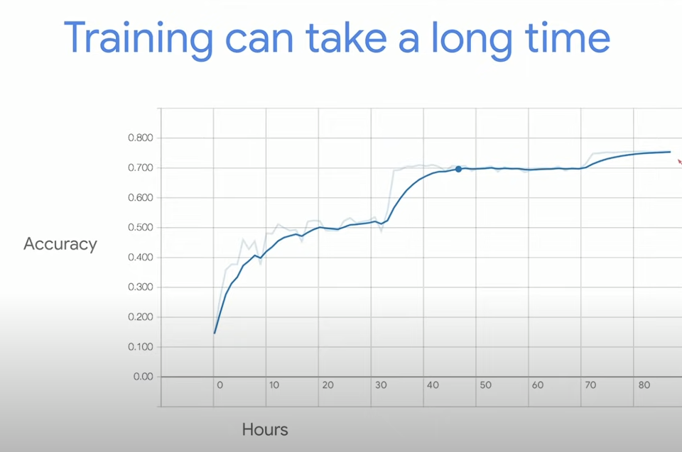
Monitoring Training Progress

Slide 15
Outline
OpendTect Machine Learning Plugin
Workflows
Pre-Trained Models
Experimentation
Development Environment
Architecture
Keras and Tensorflow
OpendTect API
IDE
Notebooks
Putting it all together
Prepare development environment
Launch Python shell
Launch favorite IDE
Create a Notebook
Demonstrate workflow using plugin and notebook together

Slide 16
OpendTect Python API
OpendTect Machine Learning Plugin
Workflows
Pre-Trained Models
Experimentation
Development Environment
Architecture
Keras and Tensorflow
OpendTect API
IDE
Notebooks
Putting it all together
Prepare development environment
Launch Python shell
Launch favorite IDE
Create a Notebook
Demonstrate workflow using plugin and notebook together
Ecosystem of Python applications
OpendTect <> HDF5 format
Bokeh Server for inter-process services
Keras extensions with OpendTect specific enhancements
Retrieval of Data/Models from OpendTect
Database read/write
Model extraction from ML plugin
Model creation, training and application in development environment
Model injection back to ML plugin
Take advantage of hardware
Models difficult to train, easy to apply
Train on high-end equipped machine
Share and apply on lesser-equipped machines

Slide 17
odpy Package: Generic Tools
OpendTect Machine Learning Plugin
Workflows
Pre-Trained Models
Experimentation
Development Environment
Architecture
Keras and Tensorflow
OpendTect API
IDE
Notebooks
Putting it all together
Prepare development environment
Launch Python shell
Launch favorite IDE
Create a Notebook
Demonstrate workflow using plugin and notebook together
Common utils
Logging (information logs)
Attach to OpendTect binaries
OpendTect data access
dbman - database
wellman – well data specific
browse_hdf5_seis & volpreload – volume data specific
Other hdf5 wrappers for attributes, etc
OpendTect-OS integration
Wrap subprocess module to execute commands
Other utils

Slide 18
dgbpy Package: ML Specific Tools
OpendTect Machine Learning Plugin
Workflows
Pre-Trained Models
Experimentation
Development Environment
Architecture
Keras and Tensorflow
OpendTect API
IDE
Notebooks
Putting it all together
Prepare development environment
Launch Python shell
Launch favorite IDE
Create a Notebook
Demonstrate workflow using plugin and notebook together
ML Data and Model I/O
Direct access to models and data
Keras and Scikit-Learn wrappers
Model building, training, application external to OpendTect
ML Model Application
Directly access data in OpendTect database
Begin training, apply model
Platform independent

Slide 19
Outline
OpendTect Machine Learning Plugin
Workflows
Pre-Trained Models
Experimentation
Development Environment
Architecture
Keras and Tensorflow
OpendTect API
IDE
Notebooks
Putting it all together
Prepare development environment
Launch Python shell
Launch favorite IDE
Create a Notebook
Demonstrate workflow using plugin and notebook together
Live Demo

Slide 20
Thank you for watching
For more information visit dgbes.com or email info@dgbes.com

Slide 21
Outline
OpendTect Machine Learning Plugin
Workflows
Pre-Trained Models
Experimentation
Development Environment
Architecture
Keras and Tensorflow
OpendTect API
IDE
Notebooks
Putting it all together
Prepare development environment
Launch Python shell
Launch favorite IDE
Create a Notebook
Demonstrate workflow using plugin and notebook together

Slide 22
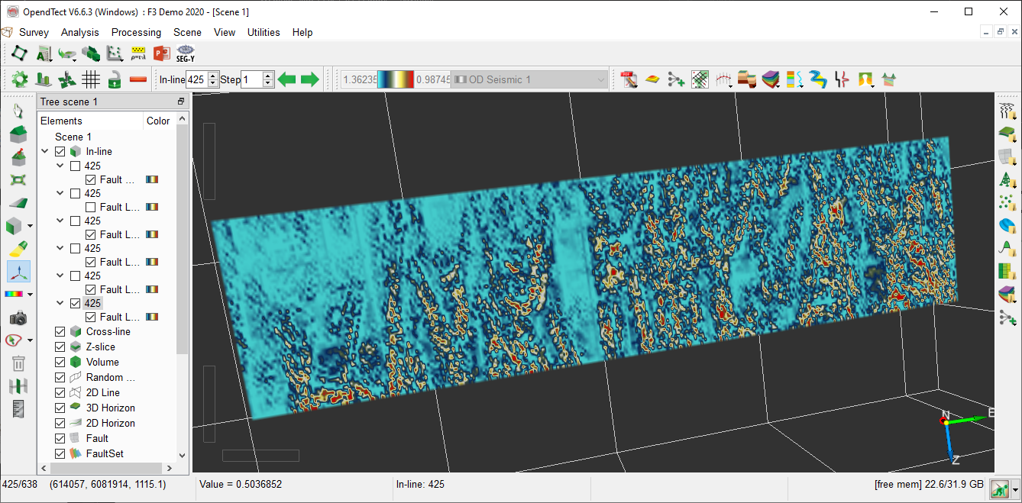

Slide 23
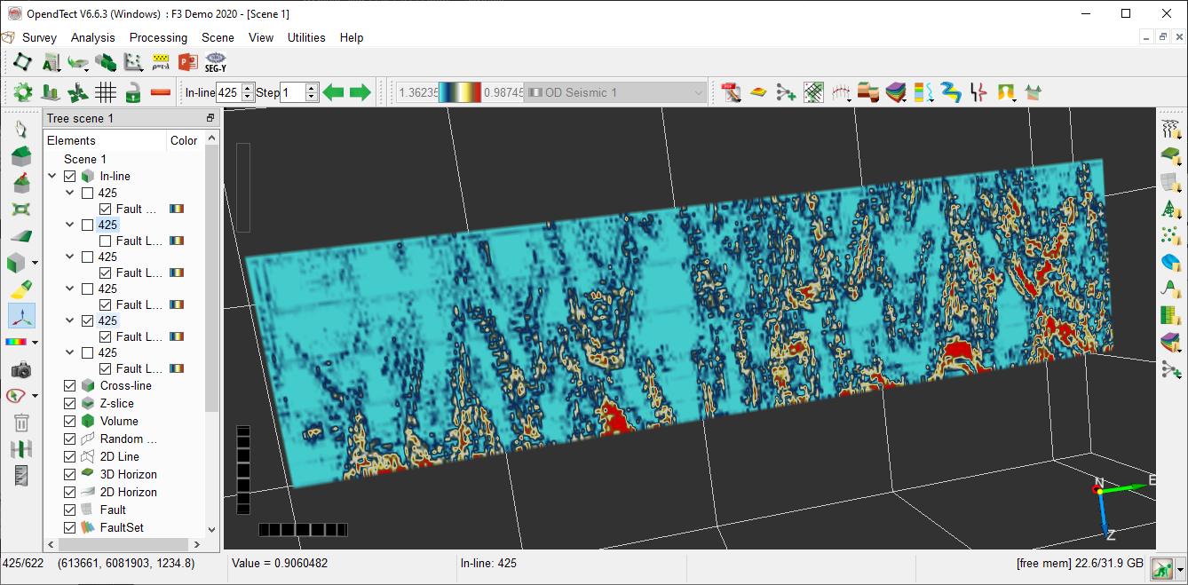

Slide 24
